Slide 1

Still working on it…
Unit 3 – Numerical Summaries, Day 2
Non-Calculating Professor Colton

Slide 2
Unit 3, Day 2 - Outline
Unit 3 – Numerical Summaries
Measures of Variation
Range
Standard Deviation
Variance
IQR
Best Measure of Variation
Standard Deviation of Grouped Data
Using the Standard Deviation
Normal Distribution
Empirical Rule
Measures of Relative Position
Percentiles
Quartiles
Outliers via Boxplots
Z-scores

Slide 3
Measures of Variation: Intro
We talked about measures of center; these give us ideas of location.
So we know where the “middle” is. Now how far do the values branch (spread) out around the middle??
To quantify this, we use a measure of spread.
Measures of Variation give an idea of the spread/variability of your data.
Smaller values, data is closer together (i.e., more consistent).
Large values, the data is spread out from one another (i.e., less consistent).
To BEST describe a dataset, we want to give the best, most appropriate measure of center paired with the best, most appropriate measure of variation!

Slide 4
Range
Range
Maybe the simplest measure of variation (spread).
Range = Max - Min
Gives idea of the entire ”range” of values, how much distance do they span in total.
Obviously range is heavily impacted by extreme observations → NOT resistant
Very easy to find in calculator, just do a 1-Var Stats to find the info you need.
Range = Max – Min = 25 – 3 = 22
New Range = 100 – 3 = 97

Slide 5
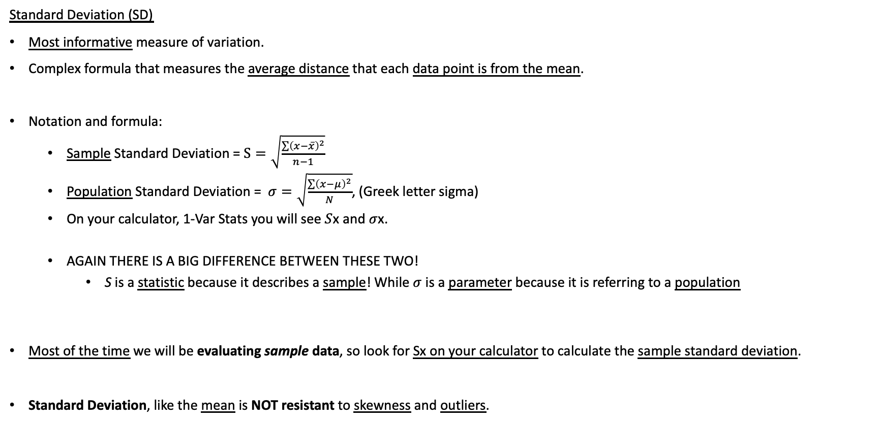
Standard Deviation
SD is found by repeating this for every point and ~ finding the average distance away
Standard Deviation (SD)
Most informative measure of variation.
Complex formula that measures the average distance that each data point is from the mean.
Notation and formula:
Sample Standard Deviation = $S=\sqrt{\frac{\sum{{\left(x−\overline{x}\right)}^{2}}}{n−1}}$
Population Standard Deviation = $σ=\sqrt{\frac{\sum{{\left(x−μ\right)}^{2}}}{N}}$, (Greek letter sigma)
On your calculator, 1-Var Stats you will see$S$x and $σ$x.
AGAIN THERE IS A BIG DIFFERENCE BETWEEN THESE TWO!
S is a statistic because it describes a sample! While $σ$ is a parameter because it is referring to a population
Most of the time we will be evaluating sample data, so look for Sx on your calculator to calculate the sample standard deviation.
Standard Deviation, like the mean is NOT resistant to skewness and outliers.
Adding this new point causes the standard deviation to increase alot

Slide 6
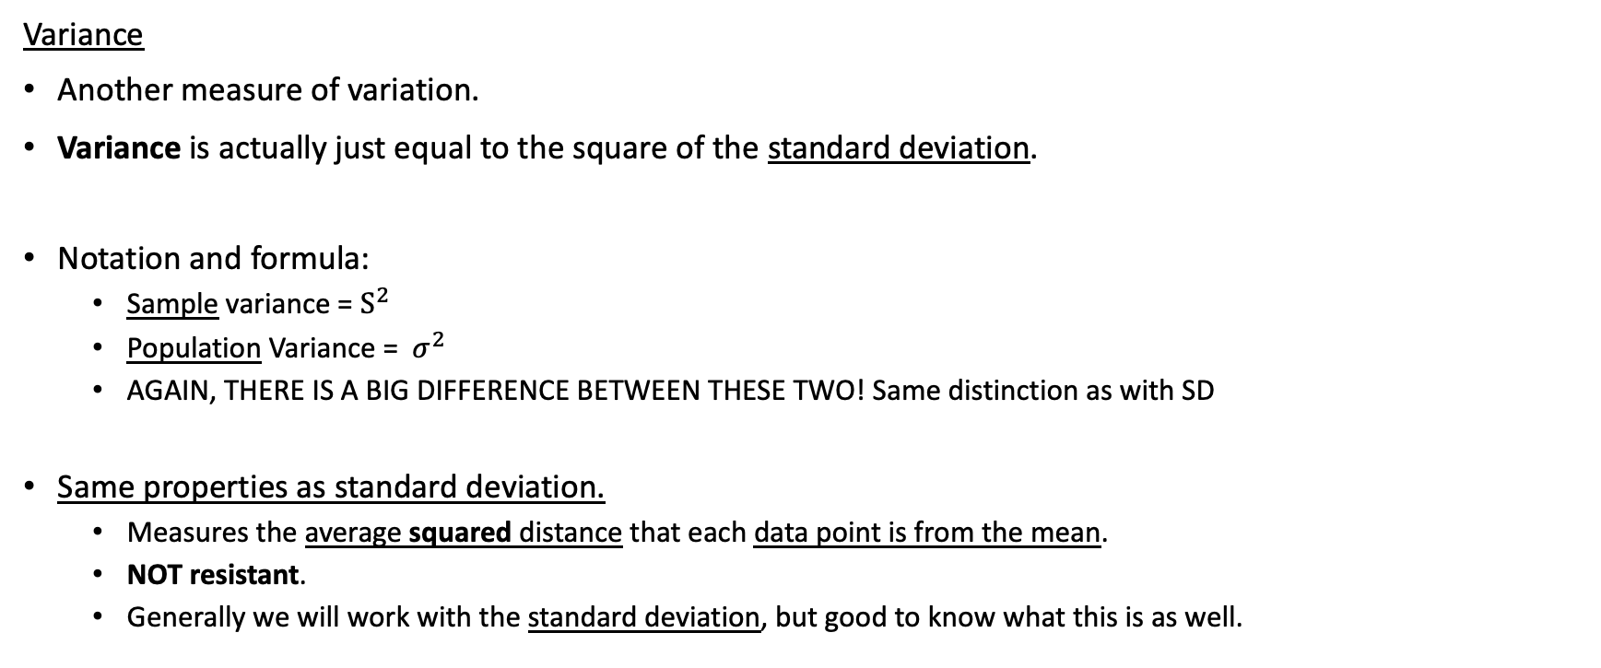
Variance
Variance
Another measure of variation.
Variance is actually just equal to the square of the standard deviation.
Notation and formula:
Sample variance = $S^{2}$
Population Variance = $σ^{2}$
AGAIN, THERE IS A BIG DIFFERENCE BETWEEN THESE TWO! Same distinction as with SD
Same properties as standard deviation.
Measures the average squared distance that each data point is from the mean.
NOT resistant.
Generally we will work with the standard deviation, but good to know what this is as well.

Slide 7
LCQ: Standard Deviation and Variance
Determine the population variance and population standard deviation of the following population.
Data: 23, 34, 12, 33, 24, 40, 33, 35, 32, 20
Approximate the population variance and population standard deviation of the following sample.
Data: 23, 34, 12, 33, 24, 40, 33, 35, 32, 20
Lets say this data is from a sample of the number of eggs hens laid in the month. Interpret the standard deviation in context.

Slide 8
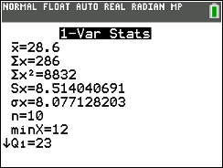
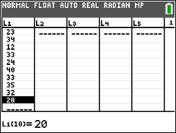
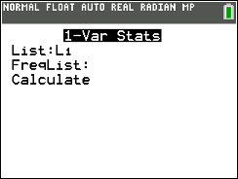
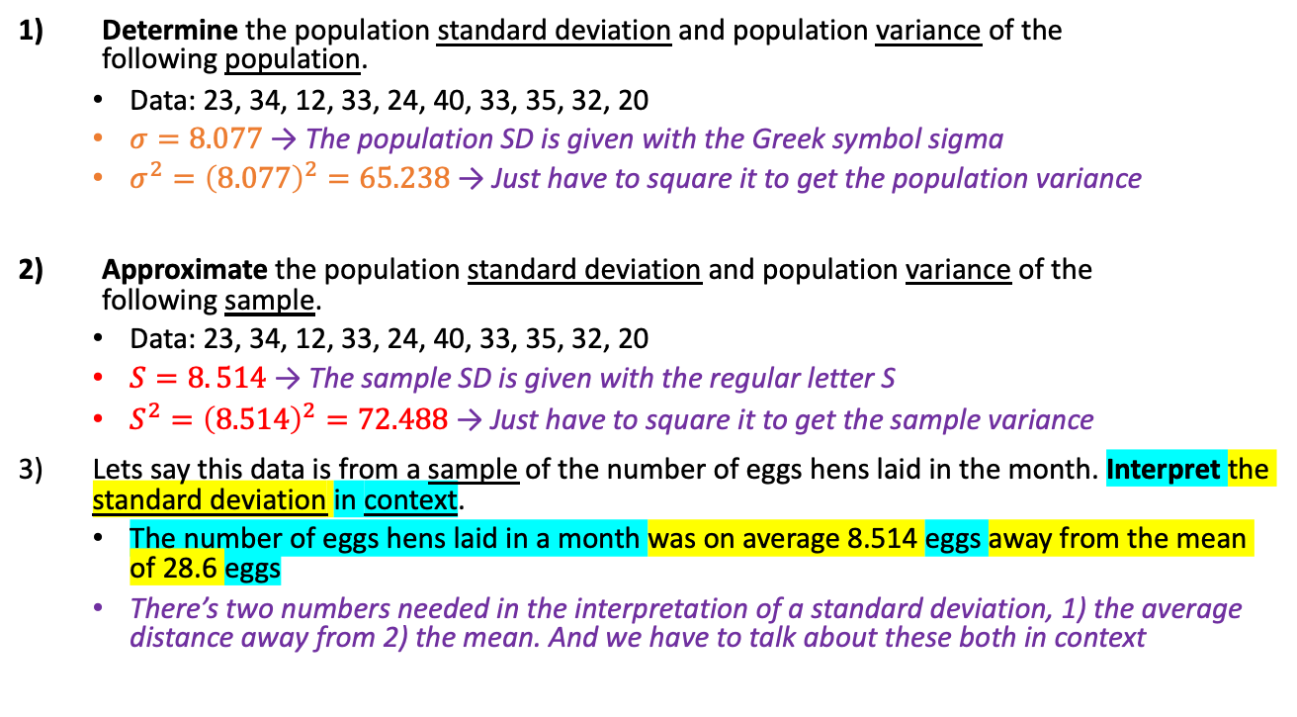
LCQ: SD and Variance
Determine the population standard deviation and population variance of the following population.
Data: 23, 34, 12, 33, 24, 40, 33, 35, 32, 20
$σ=8.077$ → The population SD is given with the Greek symbol sigma
$σ^{2}={\left(8.077\right)}^{2}=65.238$ → Just have to square it to get the population variance
Approximate the population standard deviation and population variance of the following sample.
Data: 23, 34, 12, 33, 24, 40, 33, 35, 32, 20
$S=8. 514$ → The sample SD is given with the regular letter S
$S^{2}={\left(8.514\right)}^{2}=72.488$ → Just have to square it to get the sample variance
Lets say this data is from a sample of the number of eggs hens laid in the month. Interpret the standard deviation in context.
The number of eggs hens laid in a month was on average 8.514 eggs away from the mean of 28.6 eggs
There’s two numbers needed in the interpretation of a standard deviation, 1) the average distance away from 2) the mean. And we have to talk about these both in context
The difference between number one and two is about perspective!
In number one we are viewing this data set as the entire population. It includes every single member of interest.
So when we’re finding the standard deviation and variance, they represent population values
Whereas in number two we are viewing the same set of data, but now as a subset of our overall population
So it only includes a portion of the members of interest. Now it becomes a statistic because it’s about a sample
And remember the reason why we are sampling is because we cannot measure everybody in the population
The hope is that our sample information (our sample statistics) will be close to / estimate well the population information if we were actually able to obtain it

Slide 9
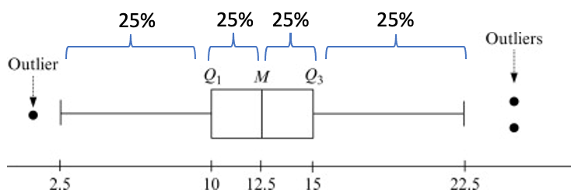
IQR
1st half
2nd half
Inter Quartile Range (IQR)
Another measure of variation, less informative than the standard deviation.
Uses quartiles to measure how far data is spread out around the median.
Specifically it measures the range of the middle 50% of the data
Visualized very well in boxplots! It is the length of the box!
Notation and formula:
IQR = Q3 – Q1
Q3 = median (middle) of the second half of data
Q1 = median (middle) of the first half of data
IQR, like the median is resistant to skewness and outliers.
25%
25%
25%
25%
1,1,2,2,3,(Q1)3,4,4,5,5,(M=Q2)6,6,7,7,8,(Q3)8,9,9,10,10
IQR = Q3 – Q1 = 15 – 10 = 5
https://www.sciencedirect.com/topics/mathematics/frequency-polygon

Slide 10
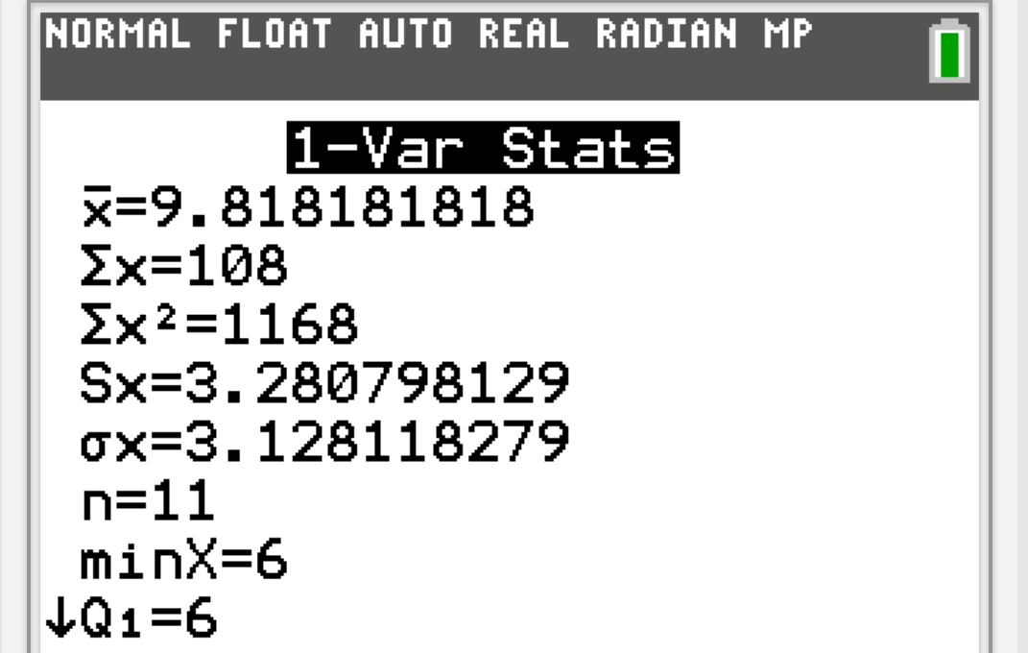
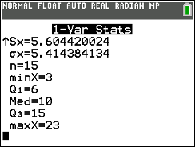
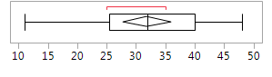
LCQ: IQR
Using this output from a 1-Var Stat, what is the IQR?
Find the IQR from this boxplot.
IQR = ???
IQR = ???

Slide 11
LCQ: IQR
Using this output from a 1-Var Stat, calculate the IQR? Calculate the range.
Find the IQR from this boxplot.
IQR = Q3 – Q1 = 15 – 6 = 9
Range = Max – Min = 23 – 3 = 20
Another common answer → Range: 3 to 23
In words this is correct, but in stats context we want the actual subtraction (so the first statement)
IQR = 40 – 25 = 15
Min Q1 Med Q3 Max

Slide 12
Best Measure of Variation
Comparison of SD and IQR
BOTH measure variation, but differently.
Standard Deviation actually uses the VALUES of each data point → MOST INFORMATIVE
IQR (for the most part) ONLY uses the POSITION of each data point.
Again, this is why SD is NOT resistant while IQR is resistant.
When to Use
SD is the most informative, so we want to use this if possible. This means when…
When data is symmetric and there is NO outliers
SD is ALWAYS reported when reporting mean!
SD blows up when there are extreme observations.
So, we DON’T report this when there are outliers or skewness to the data.
When this is the case, use the IQR.
This would now be the MOST APPROPRIATE measure of variation because it is of course unaffected by the skewness.
This is ALWAYS reported with the median.
Mean ⬄ Standard Deviation
Median ⬄ IQR
Can optionally report range, but that is NOT enough information by itself to describe the spread.

Slide 13
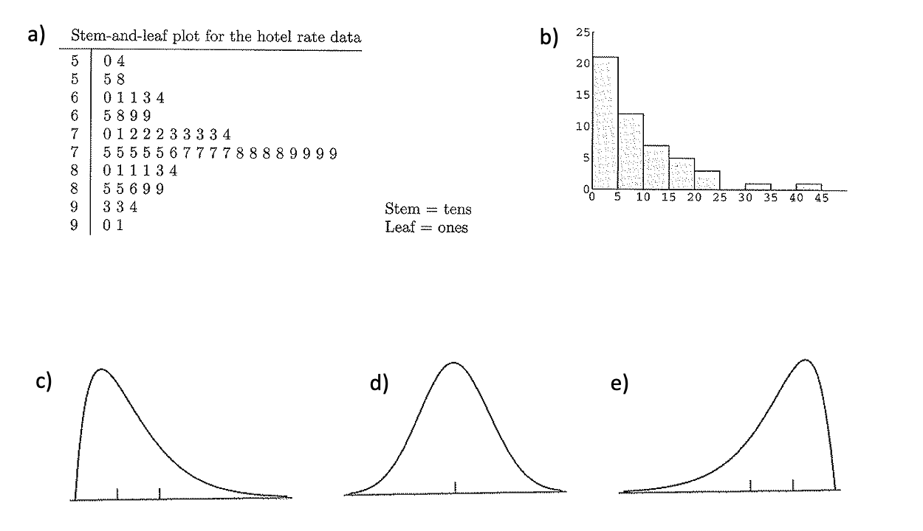
IMPORTANT LCQ: Best Measure of Variation
Which measure of variation is needed?????
Decisions
Again we are looking at the shape to determine which is the best measure of variation
Start with using the SD because it is more informative than IQR
Then use use the following two test (or conditions) on the data. If it fails either, then switch to using the IQR
Shape: Symmetric or skewed?
No outliers or outliers?
Or we can decide based on which measure of center we reported (and pick the corresponding measure of variation)!
SD (mean)
IQR (median)
IQR (median)
SD (mean)
IQR (median)

Slide 14
Center and Spread: When to Report Which
When looking to describe data by the Center and Spread, ask yourself what the shape is and if there are outliers.
If the data is symmetric and has no outliers, report the Mean for the Center. If you report the Mean for the center, report the Standard Deviation for the Spread.
If the data is not symmetric or has outliers, report the Median for the Center. If you report the Median for the center, report the IQR for the Spread.

Slide 15
LCQ / Example: SD of Grouped Data
GOAL: Find the Standard Deviation based on a Frequency Table!
Calculate Midpoints of each bin.
Enter data.
Midpoints (our estimates) go in L₁.
Frequencies (our weights) go in L₂.
1-Var Stats
List is L₁ (Midpoints).
FreqList is L₂ (Frequencies).
Calculate!
Bin | Midpoint | Frequency
55-75 | 65 | 80
75-95 | 85 | 45
95-115 | 105 | 60
115-135 | 125 | 72
Show work:

Slide 16
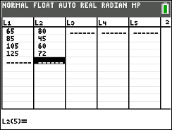
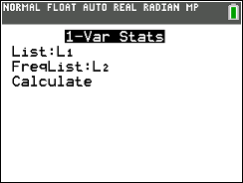
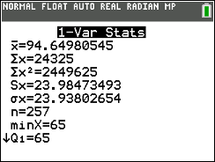
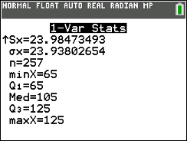
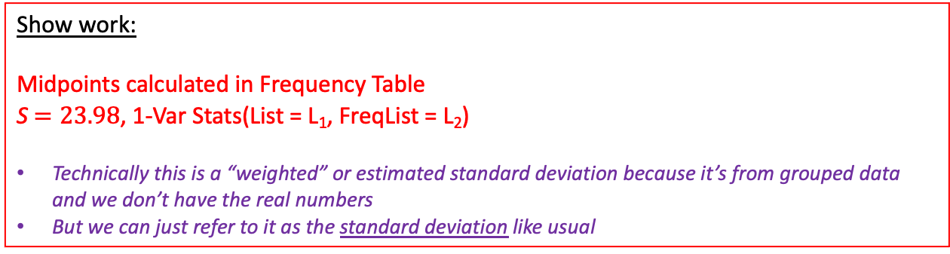
LCQ / Example: SD of Grouped Data
Bin | Midpoint | Frequency
55-75 | 65 | 80
75-95 | 85 | 45
95-115 | 105 | 60
115-135 | 125 | 72
GOAL: Find the Standard Deviation based on a Frequency Table!
Calculate Midpoints of each bin.
Enter data.
Midpoints (our estimates) go in L₁.
Frequencies (our weights) go in L₂.
1-Var Stats
List is L₁ (Midpoints).
FreqList is L₂ (Frequencies).
Calculate!
Show work:
Midpoints calculated in Frequency Table
S $=23.98$, 1-Var Stats(List = L₁, FreqList = L₂)
Technically this is a “weighted” or estimated standard deviation because it’s from grouped data and we don’t have the real numbers
But we can just refer to it as the standard deviation like usual
** This is the SAME exact process as finding the mean of grouped data!
Just looking for different information in the results

Slide 17
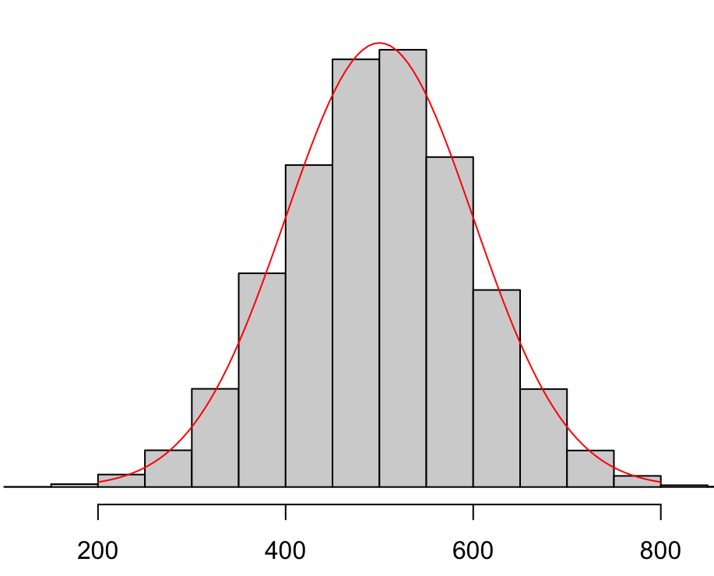
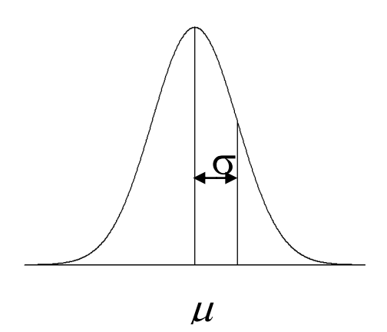
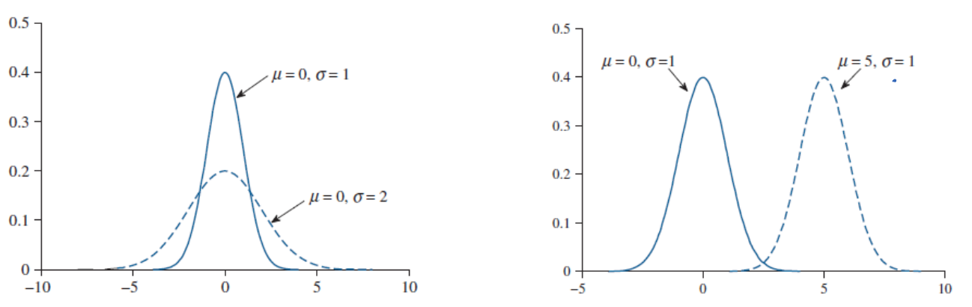
Normal Distribution
Normal Distribution
This is a special distribution to describe data that is bell-shaped
The smooth curve we can overlay is called a normal (“bell”) curve which describe normal distributions.
A normal distribution has the following properties:
Describes a continuous random variable.
It’s a symmetric, unimodal, bell-shaped distribution.
Completely described by its mean 𝜇 (which determines the location of the peak) and standard deviation 𝞂 (which measures the spread of the population)
If a random variable X follows a Normal distribution with mean 𝜇 and standard deviation 𝞂, we can summarize this in fancy stats notation with:
X ~ Normal(𝜇, 𝞂)
If we know this information (Normal, mean and SD), we know everything about this distribution!
So, we can do lots of things, like find probabilities, make generalizations, etc.

Slide 18
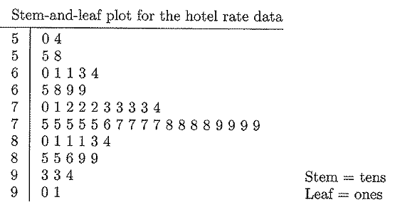
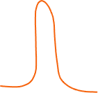
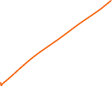

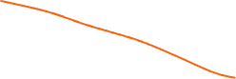
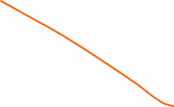
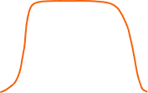
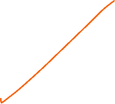
Bell-Shaped
Bell-shaped implies Normal distribution
Can NOT say that a differently shaped symmetric, unimodal distribution is Bell-shaped.
IF you say a boxplot is shape is bell → WRONG!!!!!
DON’T KNOW THE MODALITY FROM A BOXPLOT
NOT NORMAL (no bell-shape)

Slide 19
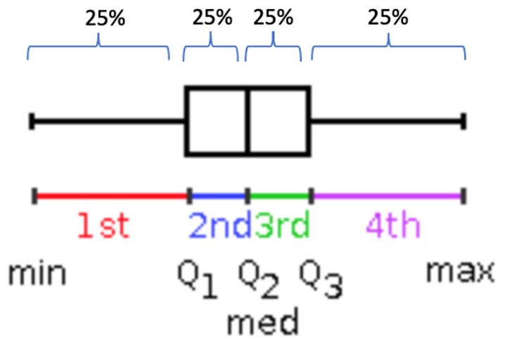
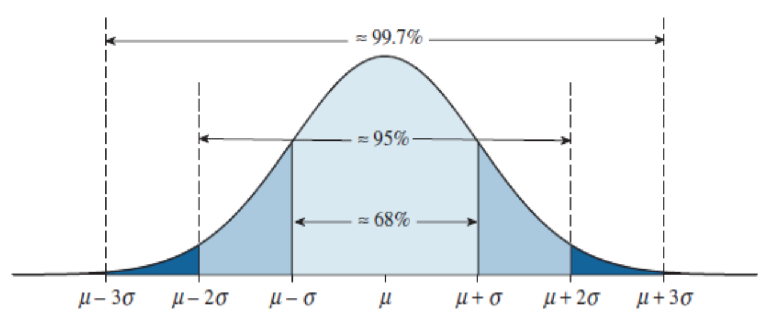
Empirical Rule Motivation
Before
With boxplots, we could find ranges with certain probabilities
Ex) Middle 50% in between Q1 and Q3, lower 25% between Min and Q1, upper 50% between Med and Max, etc.
BUT, in order to calculate a 5 number summary (and draw the boxplot), we have to have every single data point….
Now
The advantage of the Empirical Rule is that if we know these three things:
Normal distribution / Bell-shaped
Mean
Standard deviation
This can be used to make generalizations about a dataset / population without actually having the observations!
We can estimate where the middle 68%, 95% and 99.7% (nearly all) are!
1,1,2,2,3,(Q1)3,4,4,5,5,(M=Q2)6,6,7,7,8,(Q3)8,9,9,10,10
Example
Lets say ACT Scores follow a normal distribution with mean 22 and SD 4
Based on this new rule, we know between which two scores almost all students are between:
22 ± 3(4) = (10, 34)

Slide 20
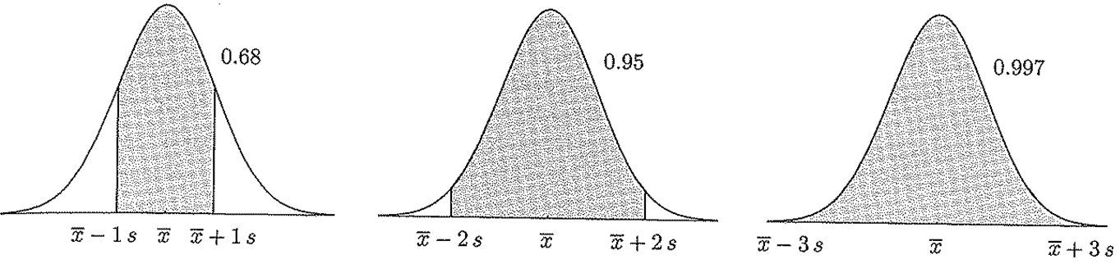
Empirical Rule
Empirical Rule (68, 95, 99.7 Rule)
If we have a normal distribution, we can generalize how much data lies within a certain distance from the mean. Specifically…
Roughly 68% of our data falls within 1 Standard Deviation of the mean
Roughly 95% of our data falls within 2 Standard Deviations of the mean
Roughly 99.7% (nearly all) of our data falls within 3 Standard Deviations of the mean
In problems, it will have to be stated that you have a Normal distribution.
We are only going to use the Empirical Rule with Normal Distributions.

Slide 21
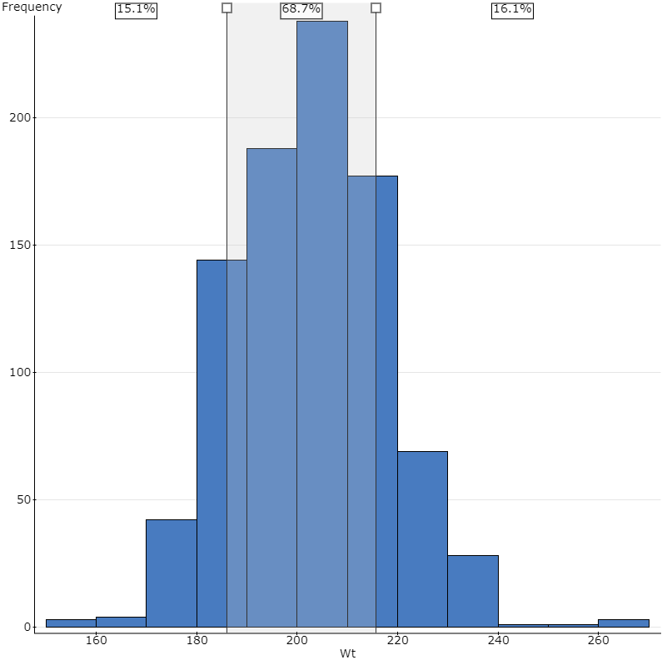
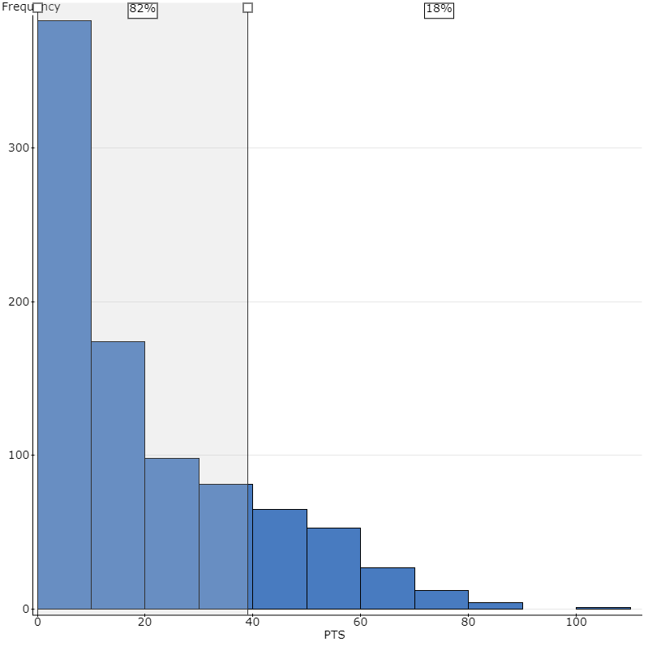
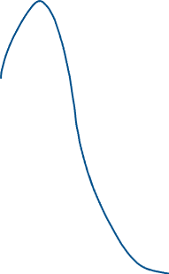
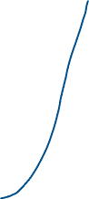
Empirical Rule: Examples for within 1 SD
Where it works
Where it doesn’t work
Roughly matches 68%, which is what it should be based on the Empirical Rule
So we can apply the rule to this data and calculate probabilities
Does NOT match 68%!
So we know the data is not bell-shaped enough
And we can NOT apply the rule

Slide 22
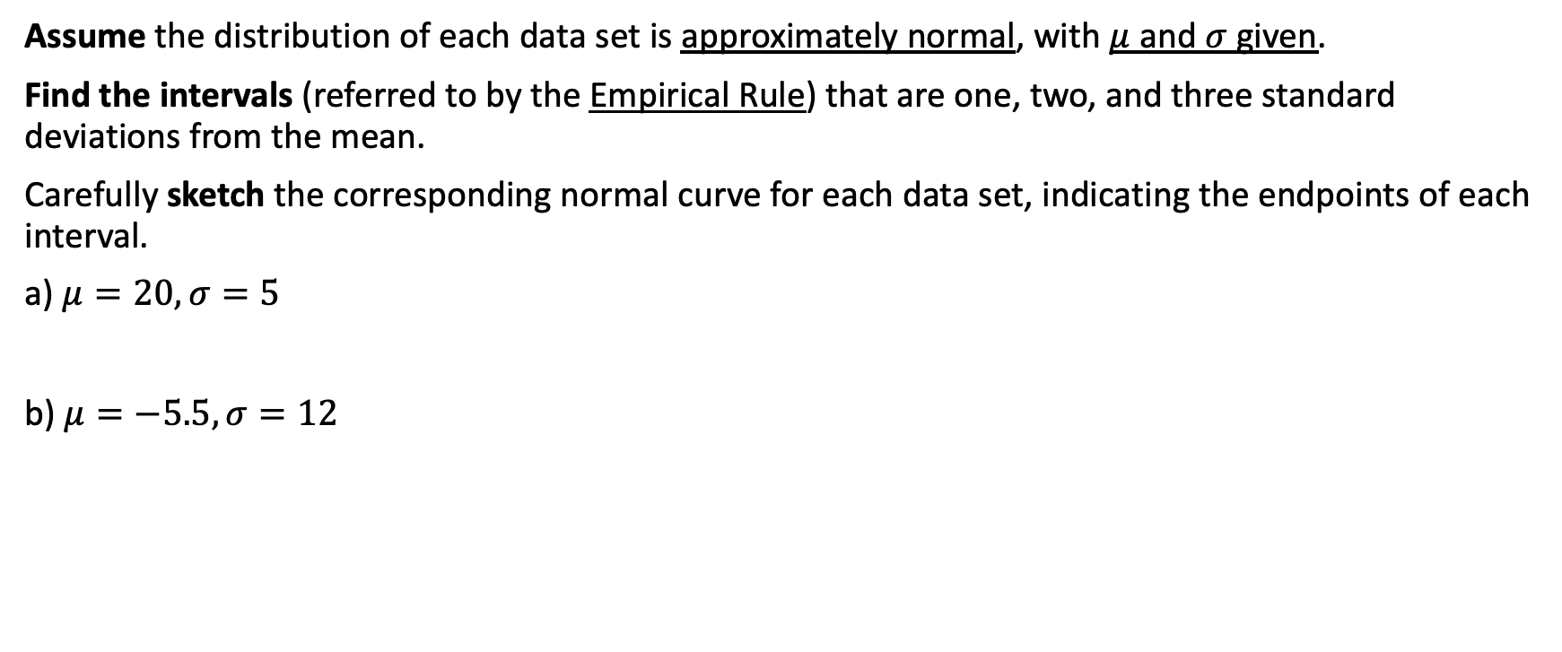
Example 1 – the Empirical Rule
Assume the distribution of each data set is approximately normal, with $μ$ and $σ$ given.
Find the intervals (referred to by the Empirical Rule) that are one, two, and three standard deviations from the mean.
Carefully sketch the corresponding normal curve for each data set, indicating the endpoints of each interval.
a) $μ=20, σ=5$
b) $μ=−5.5, σ=12$

Slide 23
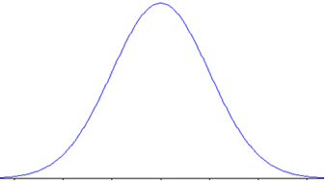
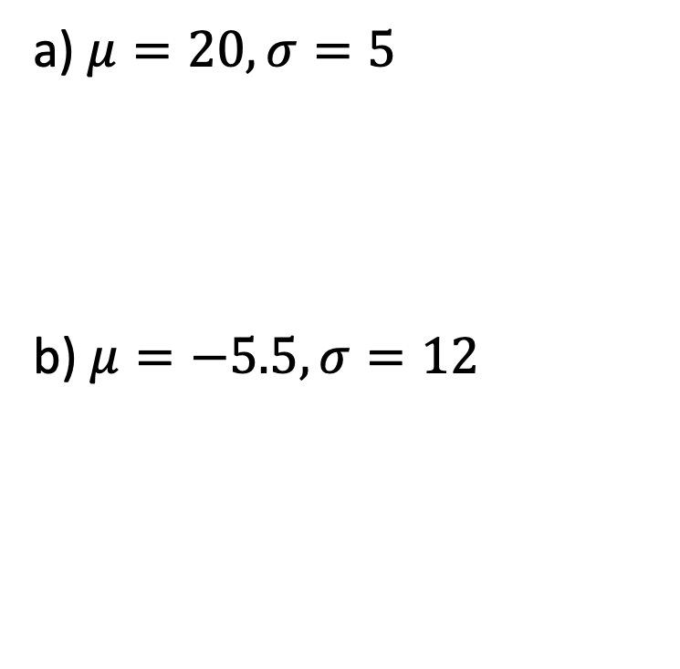
Example 1 Solution
How to Build Curve
The mean is 20, so the curve is centered at 20
Then each step outwards is of size 5 because each step represents one standard deviation (𝞂)
And we go three steps in each direction from the mean
a) $μ=20, σ=5$
b) $μ=−5.5, σ=12$
Further example:
Lets say this data for (a) was about the hours students spent at work per week.
Question: What percent of the data is within 2 standard deviations of the mean?
How can we interpret this in context?

Slide 24
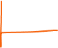

Example 1 Solution
How to Build Curve
The mean is 20, so the curve is centered at 20
Then each step outwards is of size 5 because each step represents one standard deviation (𝞂)
And we go three steps in each direction from the mean
a) $μ=20, σ=5$
b) $μ=−5.5, σ=12$
Further example:
Lets say this data for (a) was about the hours students spent at work per week.
Question: What percent of the data is within 2 standard deviations of the mean?
95% based on rule
How can we interpret this in context?
2 SDs away makes the interval (10, 30)
So according to the Empirical, approximately 95% of students work between 10 and 30 hours each week.
5 10 15 20 25 30 35
-41.5 -29.5 -17.5 -5.5 6.5 18.5 30.5

Slide 25
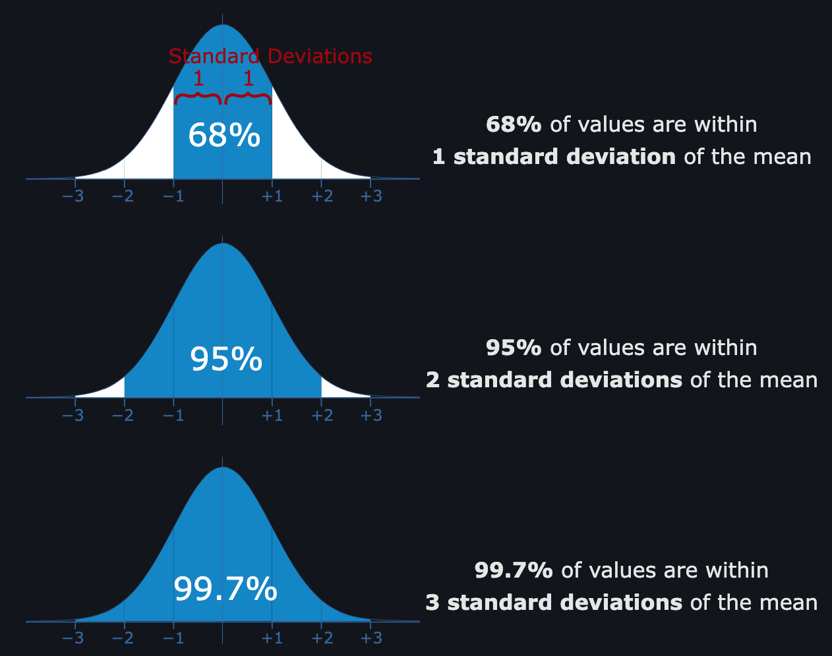
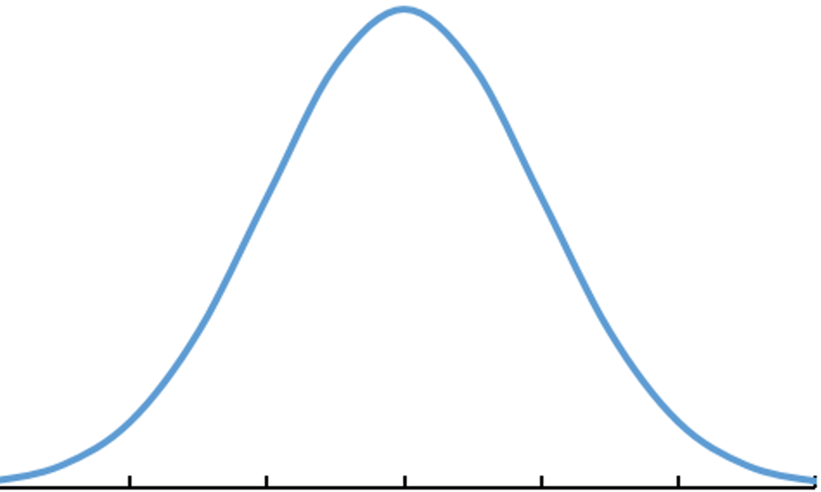
LCQ: Empirical Rule
Setup: Oak trees heights follow a normal distribution with mean 75 m and standard deviation 7 m.
a) What heights do the middle 99.7% of trees lie between?
b) What percent of Oak trees are between 68 m and 82 m?
c) Which heights are two standard deviations from the mean?
d) What percentage of trees are in between the heights from (c)?
https://www.mathsisfun.com/data/standard-normal-distribution.html

Slide 26
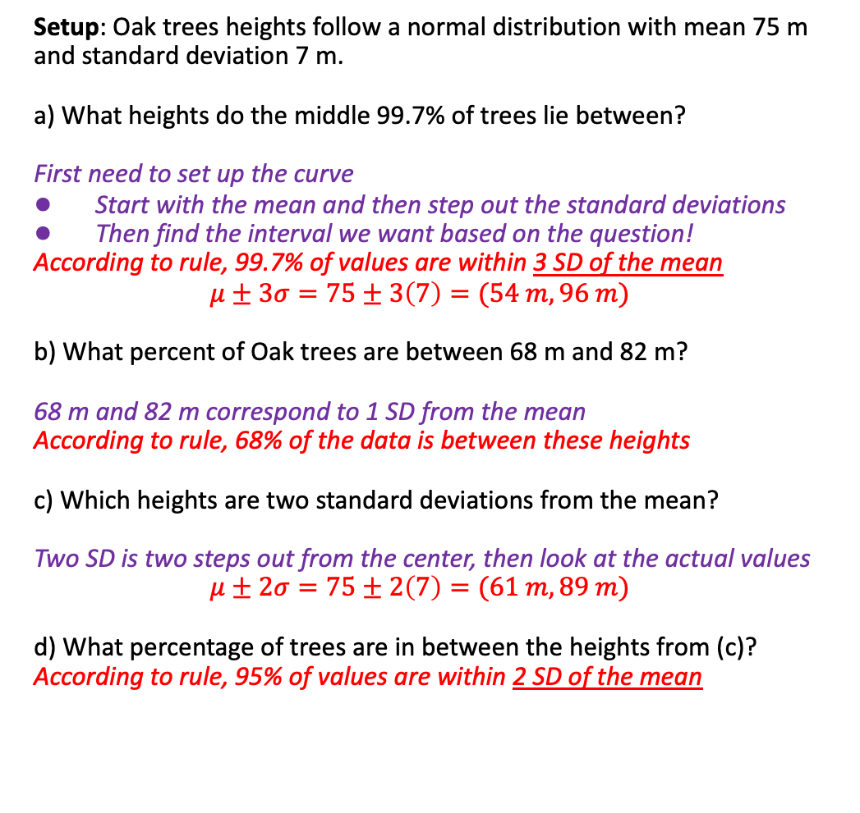
LCQ: Empirical Rule
Setup: Oak trees heights follow a normal distribution with mean 75 m and standard deviation 7 m.
a) What heights do the middle 99.7% of trees lie between?
First need to set up the curve
Start with the mean and then step out the standard deviations
Then find the interval we want based on the question!
According to rule, 99.7% of values are within 3 SD of the mean
$$μ±3σ=75±3\left(7\right)=(54 m, 96 m)$$
b) What percent of Oak trees are between 68 m and 82 m?
68 m and 82 m correspond to 1 SD from the mean
According to rule, 68% of the data is between these heights
c) Which heights are two standard deviations from the mean?
Two SD is two steps out from the center, then look at the actual values
$$μ±2σ=75±2\left(7\right)=(61 m, 89 m)$$
d) What percentage of trees are in between the heights from (c)?
According to rule, 95% of values are within 2 SD of the mean
https://www.mathsisfun.com/data/standard-normal-distribution.html
Mean µ = 75
SD 𝞂 = 7

Slide 27
Percentiles
Percentiles
A Percentile tells you the percent of observations/individuals you are higher than.
Ex: You are told you scored in the 90th percentile on GRE. This means you have a score that is higher than 90% of all others that took the test.
Range from greater than zero to 100th percentile!
There is complement aspect to percentiles as well:
Example) If you are the 80th Percentile, there is 20% greater than you!
Best way to remember!
Notation: Xth Percentile = P_{x}
How to Calculate
To determine the percentile rank of a piece of data:
Order data from smallest to largest (can use calc to do this)
Count the number of pieces of data that are numerically below or equal to that value
Divide by the sample size
Example: 1, 4, 5, 5, 7
4 is the second largest value out of 5: 2/5 = 0.4 → 40th Percentile = P₄₀
5 is the 4th largest value out of 5: 4/5 = 0.8 → 80th Percentile = P₈₀ → We want to use the second 5 because including less than OR equal to
NOTE: You might see this defined differently elsewhere, but we will stick to this for our class
P₈₀
P_{x} = some #
Percentile = % LEFT (below)
% Greater Than = 100% - Percentile
(RIGHT, above)
This is the same idea cumulative relative frequency on frequency tables!

Slide 28

Quartiles and IQR
1,1,2,2,3,(Q1)3,4,4,5,5,(M=Q2)6,6,7,7,8,(Q3)8,9,9,10,10
Quartiles
Quartiles are specific percentiles.
Q1 is the 25th Percentile.
Q3 is the 75th Percentile.
Q2 is the 50th Percentile (you will hear this called the Median more often).
Inner Quartile Range (IQR)
Remember this is another measure of spread.
It looks at the middle 50% of the data
Notation and formula:
IQR = Q3 – Q1 = P₇₅ - P₂₅
https://www.sciencedirect.com/topics/mathematics/frequency-polygon

Slide 29
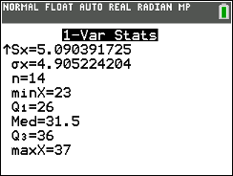
LCQ: Percentiles and Quartiles
1) We have a sample of 14 cat weights in pounds. Find is the percentile for my cat Bubbles that weighs 32 lbs.
Data: 23, 23, 25, 26, 27, 30, 31, 32, 33, 35, 36, 36, 36, 37
2) Interpret this percentile in context.
3) If my friend’s cat Mr. Tibbles is in the upper 20% of cat weights, what is his percentile?
4) For any given dataset, what is the percentile for the maximum value?
5) Find the 5-number summary for the dataset in Question 1.
6) What weight is 75% of the cat weights greater than?

Slide 30


LCQ: Percentiles and Quartiles
P_{x} = some #
Percentile = % LEFT (below)
% Greater Than = 100% - Percentile
(RIGHT, above)
1) We have a sample of 14 cat weights in pounds. Find is the percentile for my cat Bubbles that weighs 32 lbs.
Data: 23, 23, 25, 26, 27, 30, 31, 32, 33, 35, 36, 36, 36, 37
Percentile = number of observations less or equal to / sample size = 8 / 14 = 0.57 → 57th percentile
2) Interpret this percentile in context.
Multiple ways we could phrase it, both are correct and imply the same thing
57% of other cats weigh less than Bubbles
Bubbles is heavier than 57% of the other cats
3) If my friend’s cat Mr. Tibbles is in the upper 30% of cat weights, what is his percentile?
70th percentile → Remember the complement aspect to Percentiles
If there is 30% ABOVE (this is what you should think when read “upper 30%”, there must be 100% - 30% = 70% BELOW. And Percentiles ALWAYS refer to the % BELOW
4) For any given dataset, what is the percentile for the maximum value?
100th Percentile → All of the data is obviously equal to or less than the max, so 100%
5) Find the 5-number summary for the dataset in Question 1.
1-Var Stat(List = L₁)
Min = 23, Q1 = 26, Med = 31.5, Q3 = 36, Max = 37
6) What weight is 75% of the cat weights greater than?
75% greater == 25% less → 25th Percentile = Q1 = 26 lbs
This Is just using the complement aspect and recognizing that Q1 corresponds to the 25th Percentile!

Slide 31
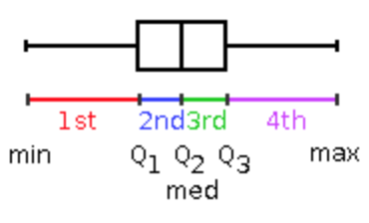
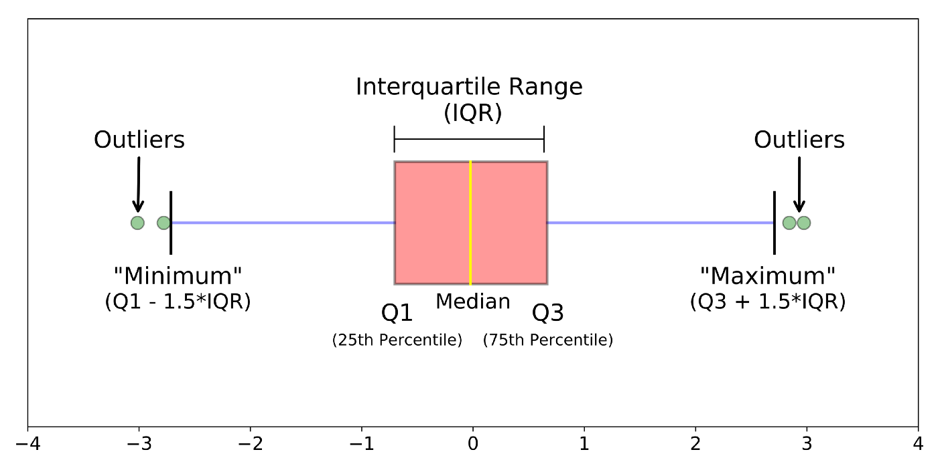
Outliers via Boxplots
Two Types of Boxplots
Regular boxplot
Left fence is at the minimum and right fence is at the maximum.
Modified (“Advanced”) boxplot
Outliers are drawn separately.
Fences are drawn at the next values that are NOT considered outliers!
How do we classify a point as an outlier?????
Outliers
An outlier is an observation that is different/far away from the other observations.
We define ‘far away’ as any data that are more than 1.5 times the box length away from the box.
This can be figured out by hand, but we are just going to draw modified boxplots to determine if / where the outliers are.
https://towardsdatascience.com/understanding-boxplots-5e2df7bcbd51

Slide 32
LCQ: Outliers via Boxplots
Problem
Come back to the cat data, but now with two additional kittens:
Data: 5, 10, 23, 23, 25, 26, 27, 30, 31, 32, 33, 35, 36, 36, 36, 37
Determine which (if any) of our new kittens are outliers by graphing the modified boxplot

Slide 33
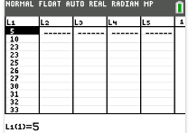
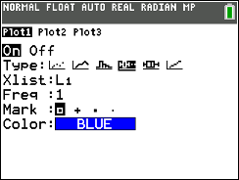
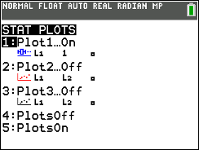
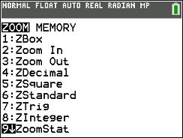
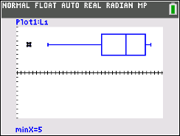
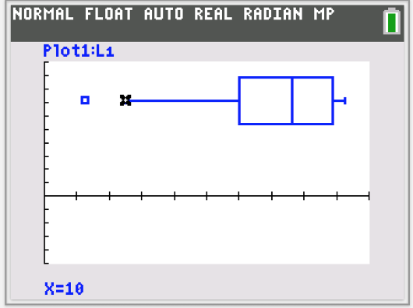

LCQ: Outliers via Boxplots
Calc Steps Again
Enter data in L₁
Setting the STAT PLOT for the boxplot with outliers should already be done
We can leave this set so it is like our “default” option now
Now we will reset the Zoom
Remember we have to do this each time we make a new boxplot
Graph and Trace!
Problem
Come back to the cat data, but now with two additional kittens:
Data: 5, 10, 23, 23, 25, 26, 27, 30, 31, 32, 33, 35, 36, 36, 36, 37
Determine which (if any) of our new kittens are outliers by graphing the modified boxplot
Show work (on Quiz or Exam)
Entered data in L1, graphed modified boxplot
This shows data point @ 5 is an outlier, while 10 is NOT an outlier
Explain what you did in the calc, interpret the resulting image and give a sketch as well!
ALL of this is what would be expected for FULL CREDIT!!
1)
2)
Modified boxplot
3)
4)

Slide 34
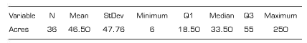
LCQ: Review
Here are summary statistics for the sizes (in acres) of upstate New York vineyards.
If my house vineyard is in the 17th percentile, explain what this means?
From the summary statistics, would you describe this distribution as symmetric or skewed? Explain.
Using these summary statistics, sketch a boxplot.

Slide 35

LCQ: Review
Here are summary statistics for the sizes (in acres) of upstate New York vineyards.
1) If my house vineyard is in the 17th percentile, explain what this means?
My vineyard is larger than 17% of the other upstate New York vineyards.
2) From the summary statistics, would you describe this distribution as symmetric or skewed? Explain.
The distribution is skewed right since the mean is greater than the median.
3) Using these summary statistics, sketch a boxplot.

Slide 36
How to compare values on different scales??
Scenario
You and your friend are very competitive and want to know who did better on their college entrance exam!
But you took the ACT and your friend took the SAT
Lets say you scored a 30 on the ACT
And your friend scored a 1400 on the SAT
Here is some info about the two exams overall:
How can we figure out who did better???
Maybe we can think about who’s score is further above the mean, but the scales are still wayyy different…..
 | Min | Max | Mean | St Dev
ACT | 1 | 36 | 23 | 4
SAT | 400 | 1600 | 1000 | 180

Slide 37

Z-Scores Example
The Mean Corporation has two major franchise operations each with many outlets across the country: a coffee house franchise and a fast food franchise. For both franchises, a statistician has collected and analyzed data for the annual profits of the outlets. Figures for the means and standard deviations are presented in the table below.
John Q owns both a coffee and fast food franchise. His annual profit for the coffee house is $377,800 and his annual profit for the fast food franchise is $838,600.
Relative to the rest of the outlets in each group, which of John Q’s stores is performing better?

Slide 38



Z-Scores Example
Relative to the rest of the outlets in each group, which of John Q’s stores is performing better?
Start by calculating the z-score each. Why? A z-score will let us see how each of John’s stores is doing in their respective groups.
Coffee:
John’s Coffee Shop is 2.7 standard deviations away from the mean performance of all coffee shops
Fast Food:
John’s Fast Food store is 1.6 standard deviations above the mean of all fast food.
Because John’s Coffee shop has a higher Z-score, it is performing better than John’s fast food within each store type.

Slide 39



Z-Scores
Z-Scores
A z-score standardizes observations based on the mean (center) and standard deviation (spread) of the distribution.
Allows for comparisons between observations from different distributions (contexts).
Can think of it as a process to cancel out the units, puts everything on a common scale
Formula
$z=\frac{x−μ}{σ}=\frac{obs −mean}{st dev}$
Interpretations (IMPORTANT!!)
Technically, a z-score tells us how many standard deviations an observation is away from the mean.
The unit of a z-score is standard deviations.
Examples:
If you have z-score of 1.5, you are 1.5 standard deviations above the mean → Of course that distance depends on the value of sigma for the context.
Think about a Z-score as the number of ‘Steps’ from the mean, and the size of the step depends on the context!
Z = 0 is our reference point! When Z = 0 you are equal to the mean.
If my z-score is negative, I am below the mean; Positive z = above mean
If my z-score is 2 and yours is 2.3, you have a relatively greater value than me.
Outliers
Another way to detect outliers! → If a z-score is above 2 or below -2, we can say that the observation is unusual
 | Min | Max | Mean | St Dev
ACT | 1 | 36 | 23 | 4
SAT | 400 | 1600 | 1000 | 180
Return to Example
Using Z-scores, we get the following results:
Try the calculations on your own!
So, your friend performed better on their exam, relative to all others who took the same exam!
 | Score | Z-Score
You (ACT) | 30 | 1.75
Friend (SAT) | 1400 | 2.22
Here, you are 1.75 ‘steps’ above the mean µ and each step is size 4, the original St Dev 𝞂

Slide 40


LCQ: Z-scores
$$z=\frac{x−μ}{σ}$$
Problem 1: For each data set with the stated $μ$ and $σ$, find the z-score corresponding to the given observation, $x$.
a) $μ=8, σ=3, x=17$
b) $μ=100, σ=16, x=80$
c) Which observation is further from the mean, relatively? Are either of these considered unusual observations?
Problem 2: For each data set with the stated $μ$ and $σ$, find the original observation x corresponding to the given z-score.
d) $μ=33, σ=6, z=−1.2$
e) $μ=−40, σ=1.5, z=3$

Slide 41

LCQ: Z-scores
$$z=\frac{x−μ}{σ}$$
Problem 1: For each data set with the stated $μ$ and $σ$, find the z-score corresponding to the given observation, $x$.
a) $μ=8, σ=3, x=17$
$z=\frac{x−μ}{σ}$ = $\frac{17−8}{3}$ = 3 → just have to plug and chug
b) $μ=100, σ=16, x=80$
$z=\frac{x−μ}{σ}$ = $\frac{80−100}{16}$ = -1.25
c) Which observation is further from the mean, relatively? Are either of these considered unusual observations?
z = 3 (a) is further from the mean (larger absolute value) → Recall absolute value is just the positive #, |z|= positive z
So this just says which is further, regardless of direction
(a) would be considered unusual because more than 2 SD away from mean (|z| > 2)
Problem 2: For each data set with the stated $μ$ and $σ$, find the original observation x corresponding to the given z-score.
d) $μ=33, σ=6, z=−1.2$
Start wit the formula that we know, and plug in the values we have:
$z=\frac{x−μ}{σ}\text{→}−1.2=\frac{x−33}{6}$ → now solve for x with algebra → $x=25.8$
25.8 is below the mean which makes sense because there was a negative Z score
e) $μ=−40, σ=1.5, z=3$
$z=\frac{x−μ}{σ}\text{→} 3=\frac{x−(−40)}{1.5}$ → now solve for x with algebra → $x=−35.5$
Now -35.5 is above the mean, positive z-score

Slide 42



Z-Scores and Standard Normal Curve
But when starting with a Normal distribution, we get a result that is very common!
Standard Normal Curve
Just a specific Normal distribution that has mean mean 𝜇 = 0 and standard deviation 𝞂 = 1
If a random variable follows a Standard Normal distribution then,
Z ~ Normal(𝜇 = 0, 𝞂 = 1)
Z-Score - Conceptual
We can standardize ANY distribution, i.e. turn it into z-scores.
** After standardizing (i.e. converting to Z), our new distribution has mean $μnew=0$
if x = µ → $z=\frac{x−μ}{σ}=\frac{μ −μ}{σ}=0$
and SD $σnew=1$
(This is why the new Z-scores scale has “steps” equal to 1, which represent 1 SD, 1 Z-score)
https://www.mathsisfun.com/data/standard-normal-distribution.html

Slide 43



Empirical Rule Again
Return to Empirical!
Empirical Rule (68, 95, 99.7 Rule)
If we have a Normal distribution:
Roughly 68% of the data is within 1 SD of the mean, 1 Z-SCORE!
Roughly 95% of the data is within 2 SDs of the mean, 2 Z-SCORES!
Roughly 99.7% (nearly all) of the data is within 3 SDs of the mean, 3 Z-SCORES!
We can also break the curve down into smaller sections and find those probabilities!
math.net/normal-distribution
https://spot.pcc.edu/~evega/

Slide 44
LCQ: Summary
Setup: Oak trees heights follow a normal distribution with mean 75 m and standard deviation 7 m.
a) The 50th Percentile of tree heights corresponds to what height?
b) What percentile is a height of 68m?
c) What percent of trees are taller than 89 m?
d) What heights would be considered outliers?
e) Is a tree height of 60 m more extreme than a height of 92 m? Why or why not?
https://www.mathsisfun.com/data/standard-normal-distribution.html
Mean µ = 75
SD 𝞂 = 7

Slide 45



LCQ: Summary
Setup: Oak trees heights follow a normal distribution with mean 75 m and standard deviation 7 m.
a) The 50th Percentile of tree heights corresponds to what height?
Percentile = % to the left
This is a symmetric distribution, so the mean (which is equal to the median) splits distribution in half
75m
b) What percentile is a height of 68m?
This one is trickier, we just need to think about what we know based on the rule and break the curve down into parts
We want to the left of 68
We know to the left of 75 is 50%
If we find what % is in between 68 and 75, we can just subtract from 50% to leave us with what we want!
In between 68 and 82 is 68% based on rule, and this is a symmetric interval. Which means 0.68/2 = 0.34 must be on the left side!
0.5 – 0.34 = 0.16 → 16th Percentile
c) What percent of trees are taller than 89 m?
Again, same process of breaking the curve into pieces and finding the areas we want
We want to the right of 89 (the two SD mark)
We know the middle interval at 2 SD is 95% based on the rule
Based on the complement, this means 100% - 95% is on the outside of that
And we just want the right side
1 – 0.95 = 0.05 → 0.05/2 = 0.025
https://www.mathsisfun.com/data/standard-normal-distribution.html

Slide 46

LCQ: Summary
Setup: Oak trees heights follow a normal distribution with mean 75 m and standard deviation 7 m.
d) What heights would be considered outliers?
More than 2 SD away from the mean is one way to classify points as outliers
Heights below 61 m, above 89 m
e) Is a tree height of 60 m more extreme than a height of 92 m? Why or why not?
Could probably tell visually by plotting, but to be sure we need to see which is further from the mean!
The best way to do this is with Z-scores
$z=\frac{x−μ}{σ}=\frac{60 −75}{7}=−2.14$
$z=\frac{x−μ}{σ}=\frac{92 −75}{7}=2.42$ → Larger |z| score, so height of 90 is more extreme
https://www.mathsisfun.com/data/standard-normal-distribution.html

